Slide 1
Praktikum Basis Data
SQL Server dengan SSMS

Slide 2
Perintah kueri
SELECT → ambil data
UPDATE → perbarui data
DELETE → hapus data

Slide 3
Bagian 1: Perintah Umum
Berlaku untuk perintah SELECT, UPDATE, dan DELETE

Slide 4

Pengambilan data tabel
SELECT * FROM table_name;
SELECT col1_name[, col2_name[, ...]] FROM table_name;
SELECT col_name AS alias FROM table_name;

Slide 5
Pengambilan sekian baris pertama
SELECT TOP(50) * FROM table_name;

Slide 6
Pengambilan baris yang unik
SELECT DISTINCT * FROM table_name;
SELECT DISTINCT col1_name[, col2_name[, ...]] FROM table_name;

Slide 7
Pengambilan baris bersyarat
SELECT * FROM table_name WHERE predicate;
predicate := [NOT] condition {AND | OR} [NOT] predicate
condition := expr {=, <>, !=, <=, <, >, >=} expr
expr := col_name | literal

Slide 8
Pengambilan baris bersyarat
SELECT * FROM table WHERE col1 > col2;
SELECT * FROM table WHERE col > 50 OR col < 20;
SELECT * FROM table WHERE col > 90 AND col <= 100;
SELECT * FROM table WHERE col [NOT] BETWEEN 90 AND 100;
SELECT * FROM table WHERE col [NOT] IN ('Solo', 'Palu');
SELECT * FROM table WHERE col IS [NOT] NULL;

Slide 9
Pengambilan baris bersyarat
SELECT * FROM table WHERE col LIKE '%budi%';
SELECT * FROM table WHERE col LIKE '%budi';
SELECT * FROM table WHERE col LIKE 'budi%';
SELECT * FROM table WHERE col LIKE '_i%a';

Slide 10
Pengambilan dengan pengurutan
SELECT * FROM table_name ORDER BY col ASC;
SELECT * FROM table_name ORDER BY col DESC;
SELECT * FROM table_name ORDER BY col1 ASC, col2 DESC;
SELECT TOP(50) * FROM table_name ORDER BY col ASC;

Slide 11
Bagian 2: Agregasi Baris
Berlaku untuk perintah SELECT

Slide 12
Pengelompokkan baris
SELECT * FROM table_name GROUP BY col;
SELECT * FROM table_name GROUP BY col1, col2;

Slide 13
Fungsi agregat
SELECT COUNT(*) FROM table_name;
SELECT SUM(col) FROM table_name;
SELECT AVG(col) FROM table_name;
SELECT MIN(col) FROM table_name;
SELECT MAX(col) FROM table_name;

Slide 14
Fungsi agregat
SELECT COUNT(*) FROM table WHERE conditions;
SELECT SUM(col1) FROM table GROUP BY col2;
SELECT MIN(col1) FROM table WHERE col2 > 10;

Slide 15
Pengambilan baris yang memiliki
SELECT col1, SUM(col2) FROM table
GROUP BY col3
HAVING SUM(col2) > 100;

Slide 16
Bagian 3: Perintah Banyak Tabel
Berlaku untuk perintah SELECT, UPDATE, dan DELETE

Slide 17
Penggabungan banyak tabel
SELECT * FROM A CROSS JOIN B;
SELECT * FROM A LEFT JOIN B ON A.k = B.k;
SELECT * FROM A INNER JOIN B ON A.k = B.k;
SELECT * FROM A RIGHT JOIN B ON A.k = B.k;
SELECT * FROM A FULL OUTER JOIN B ON A.k = B.k;

Slide 18
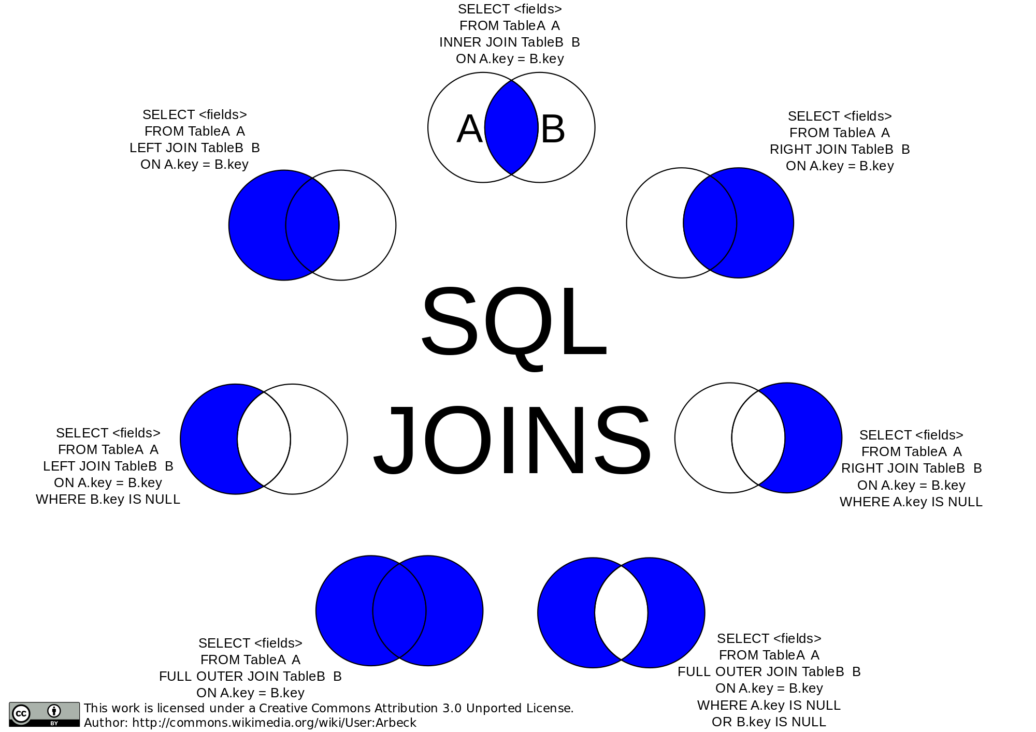

Slide 19
Penggabungan banyak kueri
SELECT * FROM A
UNION
SELECT * FROM B;
SELECT * FROM A
UNION ALL
SELECT * FROM B;

Slide 20
Bagian 4: Kueri Lain-Lain
Berlaku untuk perintah-perintah tertentu

Slide 21
Views
CREATE VIEW view_name AS SELECT * FROM table; CREATE VIEW view_name AS
SELECT col1, SUM(col2) AS sum FROM table_name
GROUP BY col3;
SELECT * FROM view_name;

Slide 22
Replace
SELECT REPLACE(text, search, replace);
SELECT REPLACE(col, s, r) FROM table;

Slide 23
Cases
CASE var
WHEN val1 THEN expr1
WHEN val2 THEN expr2
ELSE expr3
END

Slide 24
Coalesce
COALESCE(expr1, [expr2[, ...]])

Slide 25
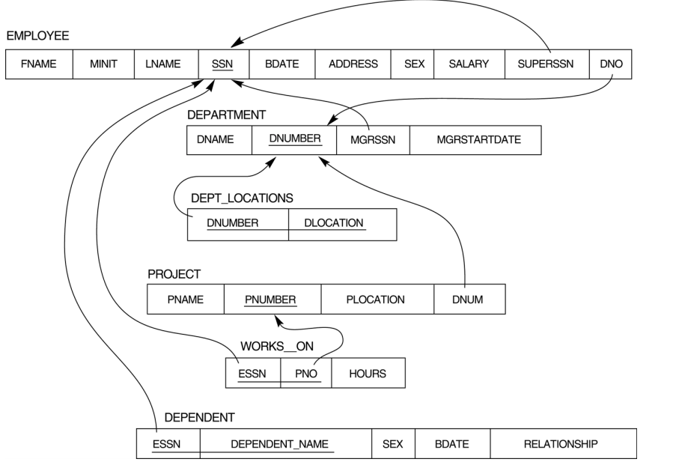
Latihan

Slide 26
Latihan
Buat kueri untuk mengambil karyawan yang jam kerjanya di atas 30 jam.
Buat kueri untuk mengambil karyawan yang departemennya memiliki dua proyek.
Buat kueri untuk menghitung total gaji karyawan yang mengikuti proyek yang total jam kerja karyawannya tertinggi.

